Slide 1

MBA 652 Statistical Methods in Business Analytics
Estimation of factors that determine hourly wages
GROUP 16
Ankit Tyagi 231250025
Debdutta Singha Roy 231250039
Kantule Ritesh Ramdas 210488
Shubham Malviya 231250131

Slide 2
Objective
To understand the factors that influence wages for workers using a variant of Mincer wage model.

Slide 3

Mincer wage model
A popular model in labor economics that tries to explain wage differences as a function of schooling and labor market experience.
In the above 'w' is wage, 's' is years of schooling and 'x' is labor market experience.

Slide 4
Data Source
Paul A. Rudd, An Introduction to Classical Econometric Theory, Oxford University Press, New York, 2000
Extract from the March, 1995 Current Population Survey of the U. S. Census Bureau. 1289 observations, 8 variables, including w (wage), fe female indicator variable), nw (nonwhite indicator), un ( (union indicator), ed (years of schooling), ex (years of potential experience), age (age), wk (weekly earnings indicator variable).

Slide 5
Influence of education, experience and social factors on wages
This study uses a variant of Mincer model to understand the factors that determine hourly wages.
The regressor variables are as follows
ed- education in years
ex- experience in years
fe- categorical variable chosen as 1 if individual is a female
nw- categorical variable chosen as 1 if individual is non-white
wn-categorical variable chosen as 1 if individual is a union member
wk- categorical variable chosen as 1 if individual is a non-hourly worker
We have not used age variable from the dataset as it is highly correlated with experience.

Slide 6
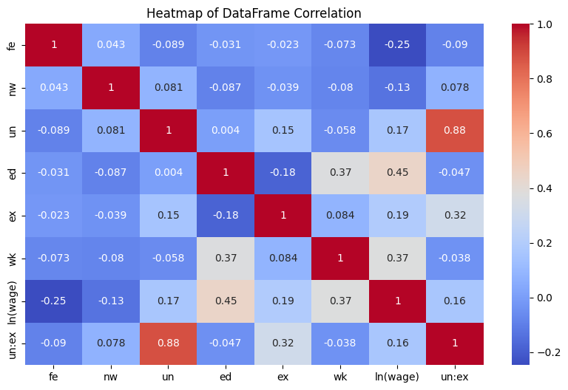
Exploratory Data Analysis
Correlation Matrix:

Slide 7
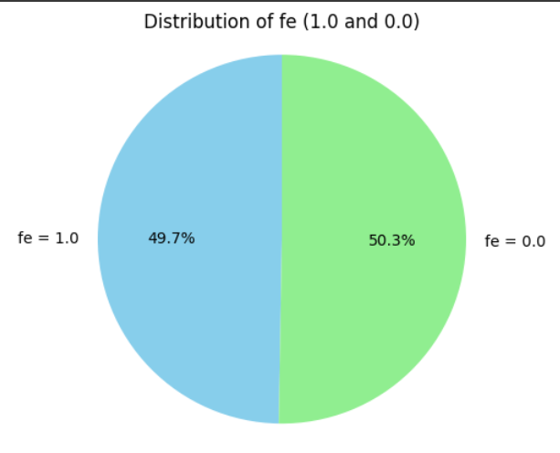
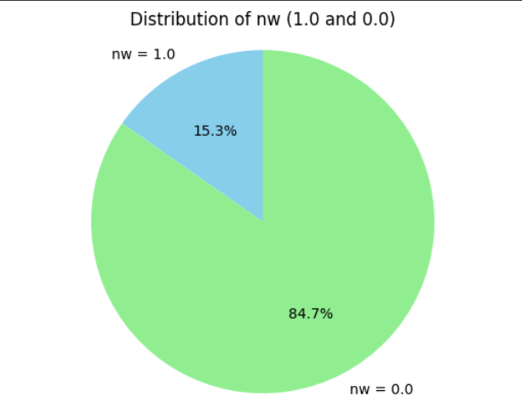
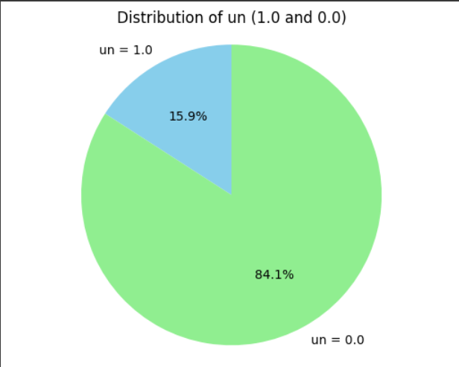
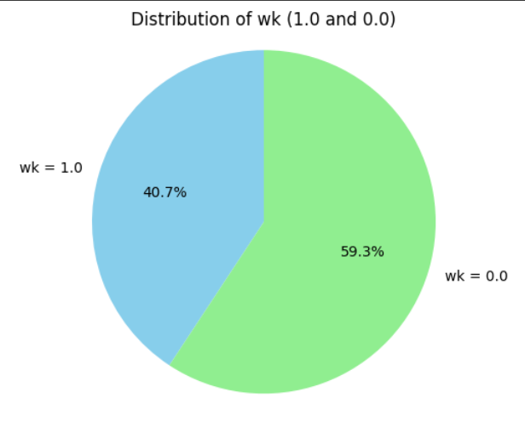
DATA DISTRIBUTION
Female:49%
Non-White: 15.3%
Workers with union:15.9%
Non Hourly wage worker:40.7%

Slide 8
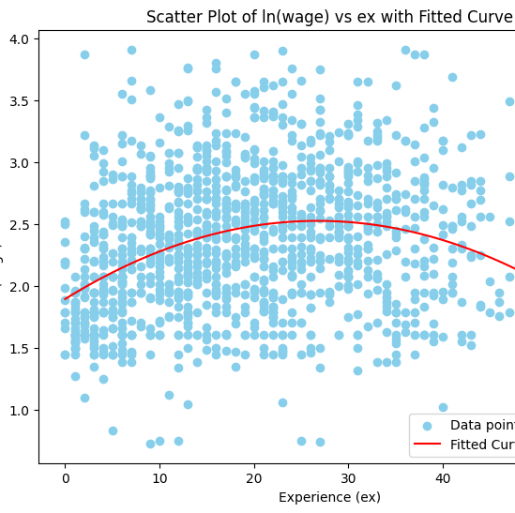
ln(wage) vs ex with Fitted Curve:
Here we see the non-linear(Parabolic) behavior. So, we will take ex^2 term in consideration

Slide 9
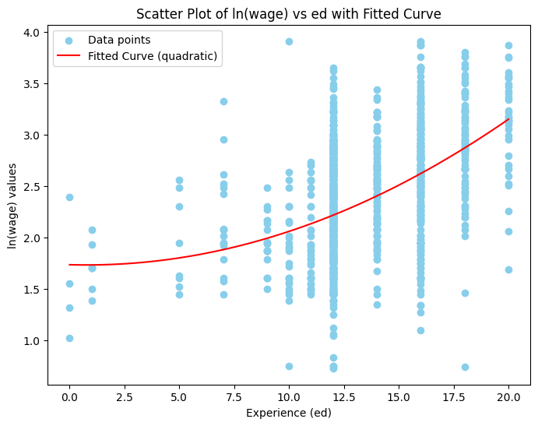
ln(wage) vs education
Non-linear(Parabolic) behavior. So, we will take ed^2 term in consideration

Slide 10
Model 1
In the first model we estimated logarithm of wage as a dependent variable using all the variables available
The results are as follows

Slide 11
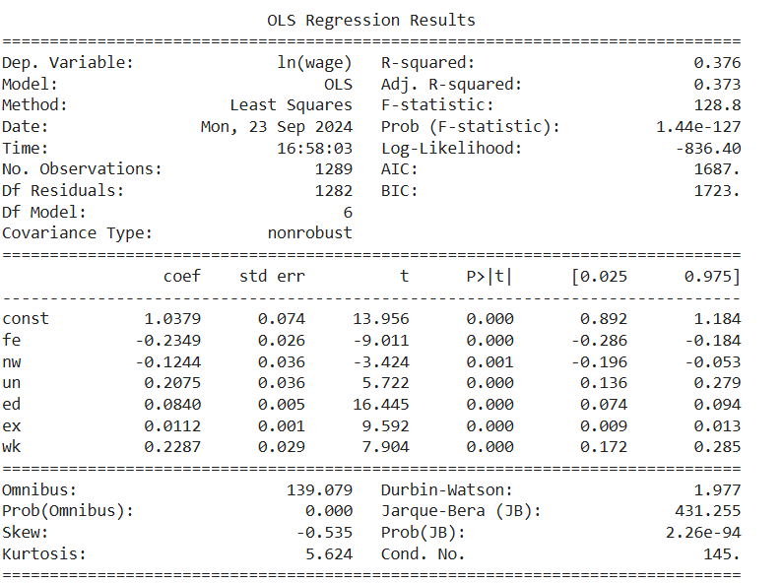
Model 1:

Slide 12
Interpretation
As can be seen, all the regressors are individually highly statistically significant based on the p-values obtained. The extremely low probability of F statistic also indicates that the variables are collectively significant as well.
The base model is an hourly wage white male worker who is non-unionized.
Based on this we can say that a female worker experiences a relative decline of 23.49% in wages as compared to a man. Similarly nonwhite male workers experience a 12.44 percentage decrease. Unionized workers make 20.75% higher wages. Extra year of education increases wage by 8.4%. One extra year of education increases wage by 1.1% and weekly paid workers make 22.87% higher than hourly wage workers.
The Adjusted R square is 37.3%.

Slide 13
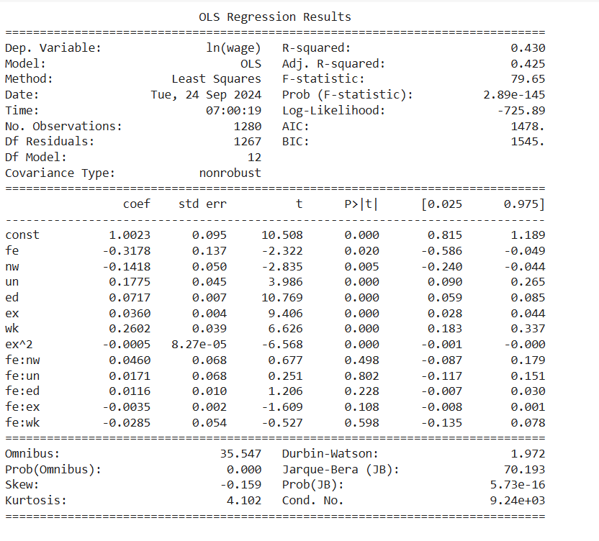
Model 2 to examine interactions between gender and other variables.

Slide 14
Interpretation
As can be seen in the results, the p values for all the interaction terms are greater than 0.05 and thus the interaction effects are insignificant.
The adjusted R square value has increased marginally.

Slide 15
Model 3 to examine the effect of including quadratic term in labor market experience
Model 1 tells us that there are positive returns to labor market experience.
However based on the graph in EDA we see that a quadratic relationship between 'ln(wage)' and 'ex' might provide a better fit

Slide 16
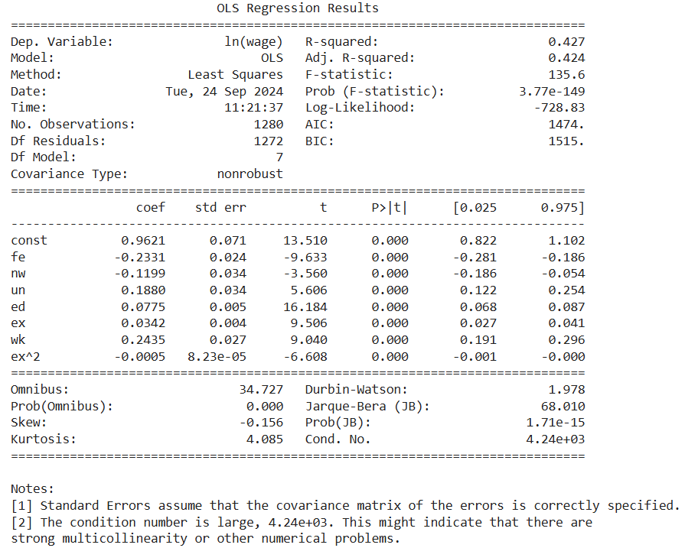
Result

Slide 17
Interpretation
As we can see, the Adjusted R square value has improved.
We can also see that the rate of wage growth slows down as experience increases.

Slide 18
Model 4 after including quadratic term in education
Based on EDA graph above we also see that a quadratic relationship would be a better fit.
So we have included a quadratic term in 'edu' variable as well.
The results are as follows

Slide 19
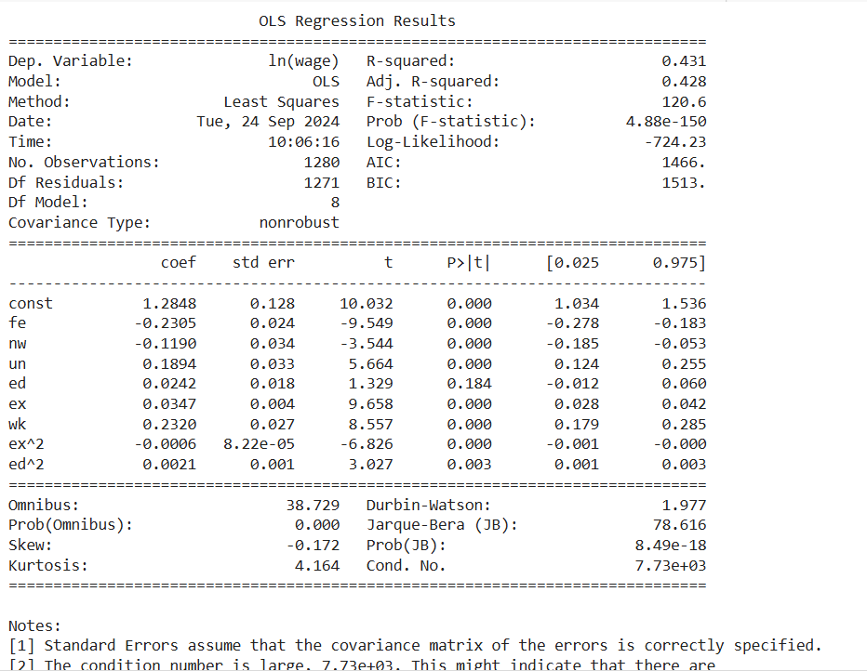
Results

Slide 20
Interpretation
The 'ed' appears to become insignificant as p value is larger than 0.05.The adjusted R-square does not see much improvement over Model 3.
We do see that the returns to education continue to increase with higher education..

Slide 21
Final Model:
ln(wage) = 1.2848 -0.2305 * fe -0.1190 * nw
+ 0.1894 * un + 0.0242 ed + 0.0347 * ex
+ 0.2320* wk -0.0006 * ex^2 + 0.0021* ed^2
•All of these variables are statistically significant other than ’ed’ considering 95% confidence interval

Slide 22
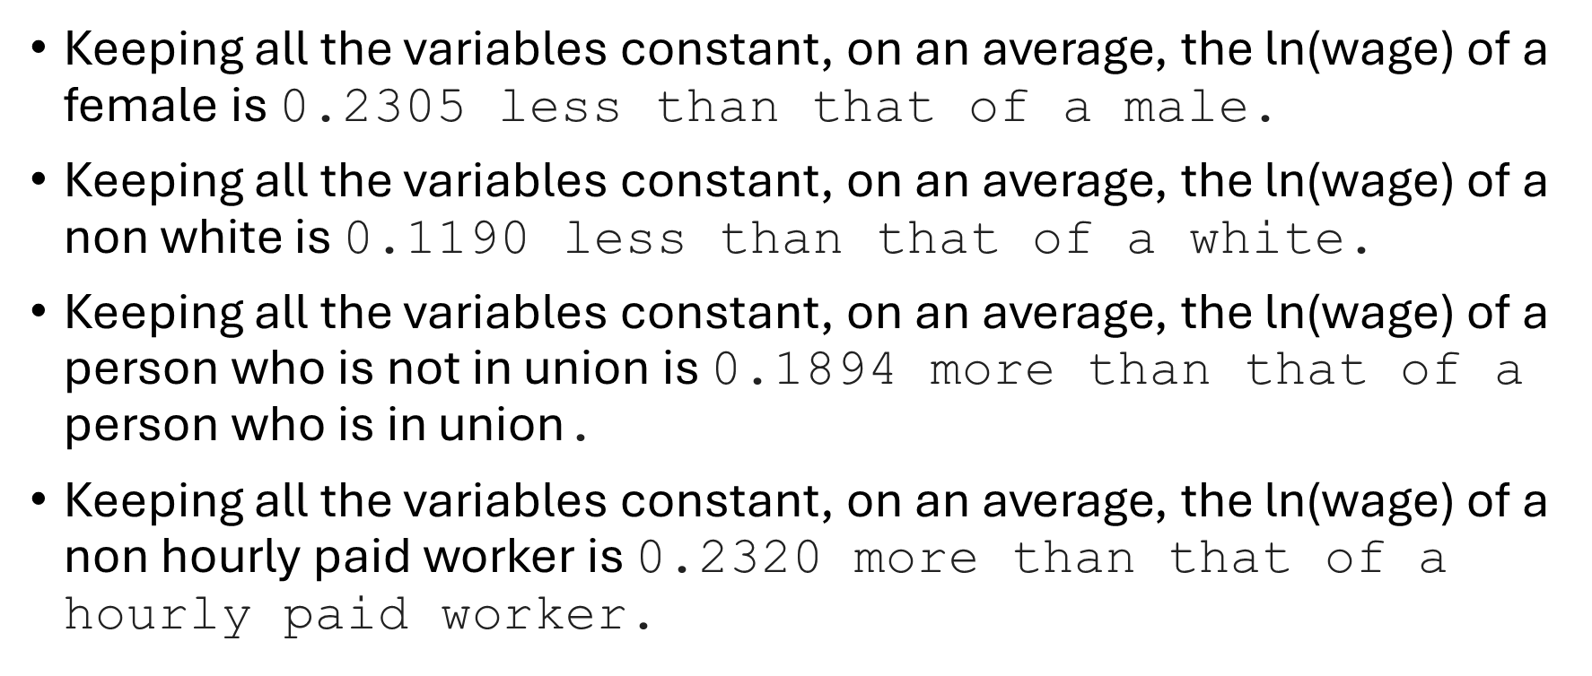
Interpretation

Slide 23
Keeping all the variables constant, on an average a unit increase in education year can increase ln(wage) by 0.0242 unit.
Keeping all the variables constant, on an average a unit increase in years of work experience can increase ln(wage) by 0.0347 unit.
This quadratic term for experience suggests that as experience increases, its effect on ln(wage) diminishes. The negative sign indicates a concave relationship, meaning that after a certain point, additional experience may lead to smaller increases or even reductions in ln(wage).
This quadratic term for education implies that the effect of education on ln(wage) accelerates as education increases, but at a diminishing rate (since the coefficient is small).

Slide 24
Testing for heteroskedasticity
We performed Bruesh-Pagan test to check for heteroskedasticity.
This statistical test assesses heteroscedasticity by testing if the residuals' variance is related to the independent variables. If the test is significant, it indicates heteroscedasticity.
Interpretation: A low p-value (typically < 0.05) indicates the presence of heteroscedasticity.
The p-value that we obtain is 0.00018524933654229093 indicating heteroskedasticity.

Slide 25
Using robust errors to account for heteroskedasticity
We used robust errors for the model and got the following result

Slide 26
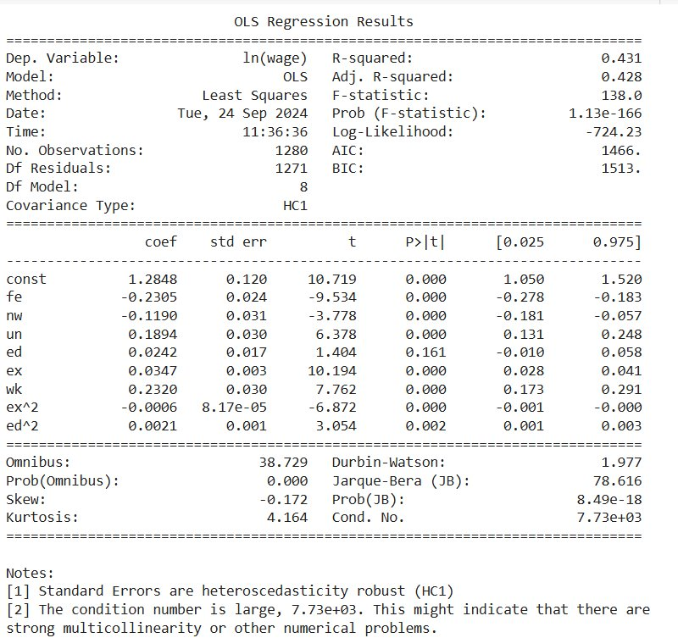
Result

Slide 27
Interpretation
The standard errors associated with variables have changed. Some p values have also changed but no change in significance of variables.

Slide 28
Omitted Variable Bias
There can be omitted variable bias due to non-inclusion of variables like marital status, number of children (under age of 6) and nonlabor income .

Slide 29
Appendix:
[Code: https://colab.research.google.com/drive/1-ZEOojm_FEu7w52iYqGTuhpRlzxuwbMp?usp=sharing ]
import pandas as pd
import numpy as np
import matplotlib.pyplot as plt
import seaborn as sns
df = pd.read_stata('wage.dta')
df.head()
df.describe()
df.info()
df.to_csv('wage.csv', index= False)
df['ln(wage)'] = np.log(df['w'])
df.head()

Slide 30
# Count the occurrences of female values
fe_counts = df['fe'].value_counts()
# Define the labels and sizes for the pie chart
labels = ['female', 'male']
sizes = [fe_counts[1.0], fe_counts[0.0]]
# Plot the pie chart
plt.pie(sizes, labels=labels, autopct='%1.1f%%', startangle=90, colors=['pink', 'blue'])
# Equal aspect ratio ensures that pie chart is drawn as a circle.
plt.axis('equal')
# Show the plot
plt.title('Distribution of female and male population')
plt.show()

Slide 31
# Count the occurrences of fe values
nw_counts = df['nw'].value_counts()
# Define the labels and sizes for the pie chart
labels = ['Non white', 'White']
sizes = [nw_counts[1.0], nw_counts[0.0]]
# Plot the pie chart
plt.pie(sizes, labels=labels, autopct='%1.1f%%', startangle=90, colors=['brown', 'lightyellow'])
# Equal aspect ratio ensures that pie chart is drawn as a circle.
plt.axis('equal')
# Show the plot
plt.title('Distribution of race')
plt.show()
#Count the occurrences of un values
un_counts = df['un'].value_counts()
# Define the labels and sizes for the pie chart
labels = ['union', 'nonunion']
sizes = [un_counts[1.0], un_counts[0.0]]

Slide 32
# Plot the pie chart
plt.pie(sizes, labels=labels, autopct='%1.1f%%', startangle=90, colors=['skyblue', 'lightgreen'])
# Equal aspect ratio ensures that pie chart is drawn as a circle.
plt.axis('equal')
# Show the plot
plt.title('Distribution of uninon and non union')
plt.show()
# Count the occurrences of fe values
wk_counts = df['wk'].value_counts()
# Define the labels and sizes for the pie chart
labels = ['weekly', 'non weekly']
sizes = [wk_counts[1.0], wk_counts[0.0]]
# Plot the pie chart
plt.pie(sizes, labels=labels, autopct='%1.1f%%', startangle=90, colors=['darkviolet', 'orange'])
# Equal aspect ratio ensures that pie chart is drawn as a circle.
plt.axis('equal')
# Show the plot
plt.title('Distribution of weekly and non weekly wage earner')
plt.show()

Slide 33
# Plot the histogram for the 'ln(wage)' column
plt.figure(figsize=(8, 6)) # Optional: Adjust figure size
plt.hist(df['ln(wage)'], bins=10, color='skyblue', edgecolor='black')
plt.title('Histogram of ln(wage)')
plt.xlabel('ln(wage) values')
plt.ylabel('Frequency')
# Show the plot
plt.show()
Q1 = df['ln(wage)'].quantile(0.25)
Q3 = df['ln(wage)'].quantile(0.75)
IQR = Q3 - Q1
# Define outlier thresholds
lower_bound = Q1 - 1.5 * IQR
upper_bound = Q3 + 1.5 * IQR
# Identify outliers
outliers = df[(df['ln(wage)'] < lower_bound) | (df['ln(wage)'] > upper_bound)]
print(outliers)
# Remove outliers
df_cleaned = df[(df['ln(wage)'] >= lower_bound) & (df['ln(wage)'] <= upper_bound)]
# Display the cleaned DataFrame
print(df_cleaned)

Slide 34
df1 = df_cleaned
df1.columns
X1=df1[['fe', 'nw', 'un', 'ed', 'ex', 'age', 'wk']]
X1.drop('age', axis=1, inplace=True)
Y=df1['ln(wage)']
X1.head()
import statsmodels.api as sm
reg_result1 = sm.OLS(Y, sm.add_constant(X1)).fit()
print(reg_result1.summary())

Slide 35
# Scatter plot of 'ln(wage)' vs 'ex'
plt.figure(figsize=(8, 6))
plt.scatter(df1['ex'], df1['ln(wage)'], color='skyblue', label='Data points')
# Fit a second-degree polynomial (quadratic curve)
coefficients = np.polyfit(df1['ex'], df1['ln(wage)'], 2)
polynomial = np.poly1d(coefficients)
# Generate x values (ex range) for plotting the fitted curve
x_vals = np.linspace(df1['ex'].min(), df1['ex'].max(), 100)
y_vals = polynomial(x_vals)
# Plot the fitted curve
plt.plot(x_vals, y_vals, color='red', label='Fitted Curve (Quadratic)')
plt.title('Scatter Plot of ln(wage) vs ex with Fitted Curve')
plt.xlabel('Experience (ex)')
plt.ylabel('ln(wage) values')
plt.legend()
# Show the plot
plt.show()

Slide 36
X2=X1
X2['ex^2'] = X2['ex']**2
X2.head()
reg_result2 = sm.OLS(Y, sm.add_constant(X2)).fit()
print(reg_result2.summary())
X3 = X2
X3['fe:nw'] = X3['fe']*X3['nw']
X3['fe:un'] = X2['fe']*X1['un']
X3['fe:ed'] = X2['fe']*X1['ed']
X3['fe:ex'] = X3['fe']*X1['ex']
X3['fe:wk'] = X3['fe']*X1['wk']
X1.head()
reg_result3 = sm.OLS(Y, sm.add_constant(X3)).fit()
print(reg_result3.summary())
X2
X2.columns
X4 = X2[['fe', 'nw', 'un', 'ed', 'ex', 'wk', 'ex^2']]
reg_result4 = sm.OLS(Y, sm.add_constant(X3)).fit()
print(reg_result4.summary())

Slide 37
plt.figure(figsize=(8, 6))
plt.scatter(df1['ed'], df1['ln(wage)'], color='skyblue', label='Data points')
# Fit a second-degree polynomial (quadratic curve)
coefficients = np.polyfit(df1['ed'], df1['ln(wage)'], 2)
polynomial = np.poly1d(coefficients)
# Generate x values (ex range) for plotting the fitted curve
x_vals = np.linspace(df1['ed'].min(), df1['ed'].max(), 100)
y_vals = polynomial(x_vals)
# Plot the fitted curve
plt.plot(x_vals, y_vals, color='red', label='Fitted Curve (quadratic)')
plt.title('Scatter Plot of ln(wage) vs ed with Fitted Curve')
plt.xlabel('Experience (ed)')
plt.ylabel('ln(wage) values')
plt.legend()
# Show the plot
plt.show()

Slide 38
X4.head()
X4['ed^2'] = X4['ed']**2
reg_result5 = sm.OLS(Y, sm.add_constant(X3)).fit()
print(reg_result5.summary())
from statsmodels.stats.diagnostic import het_breuschpagan
# Predict the values and compute residuals
predicted_vals = reg_result5.fittedvalues
residuals = reg_result5.resid
# Breusch-Pagan Test
lm_test = het_breuschpagan(residuals, sm.add_constant(predicted_vals))
print('Breusch-Pagan p-value:', lm_test[1])

Slide 39
from statsmodels.stats.outliers_influence import reset_ramsey
# Run the OLS regression
model = sm.OLS(df1['ln(wage)'], sm.add_constant(X4[['fe', 'nw', 'un', 'ed', 'ex', 'wk', 'ex^2', 'ed^2']])).fit()
# Perform the Ramsey RESET test
reset_test = reset_ramsey(model)
print('Ramsey RESET p-value:', reset_test)
"""OVB If the p-value is small (e.g., less than 0.05), there’s evidence of omitted variables or a misspecified model."""
model = sm.OLS(df1['ln(wage)'], sm.add_constant(X4[['fe', 'nw', 'un', 'ed', 'ex', 'wk', 'ex^2', 'ed^2']])).fit()
print(model.summary())
# Predict the values and compute residuals
predicted_vals = model.fittedvalues
residuals = model.resid
# Breusch-Pagan Test
lm_test = het_breuschpagan(residuals, sm.add_constant(predicted_vals))
print('Breusch-Pagan p-value:', lm_test[1])
model2 = sm.OLS(df1['ln(wage)'], sm.add_constant(X4[['fe', 'nw', 'un', 'ex', 'wk', 'ex^2', 'ed^2']])).fit()
print(model2.summary())

